Slide 1

THE HISTORY OF INTERNATIONAL SOCCER THROUGH DATA
By Benjamin Holderbein

Slide 2

TABLE OF CONTENTS
01
WHY SOCCER
02
THE QUESTION
03
THE DATA
04
ANALYSIS
05
CONCLUSIONS
Why is soccer important to me
What will I be answering
What data best answers the question
The nitty gritty
What does the data show

Slide 3

WHY SOCCER
I want to use data science in Esports
I've always loved soccer
Seems like data science is applicable

Slide 4
THE QUESTION
HOW HAS SOCCER CHANGED OVER TIME

Slide 5
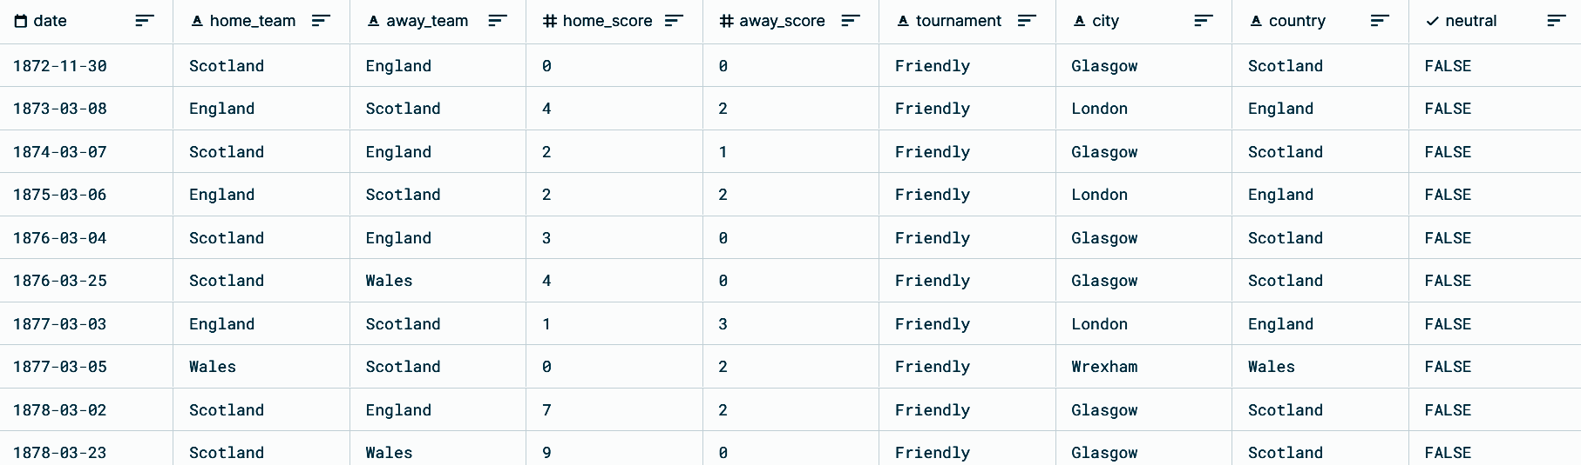

THE DATA
International football results from 1872 to 2021:
By Mart Jürisoo
Entire history of International “football” matches
42,899 Observations

Slide 6
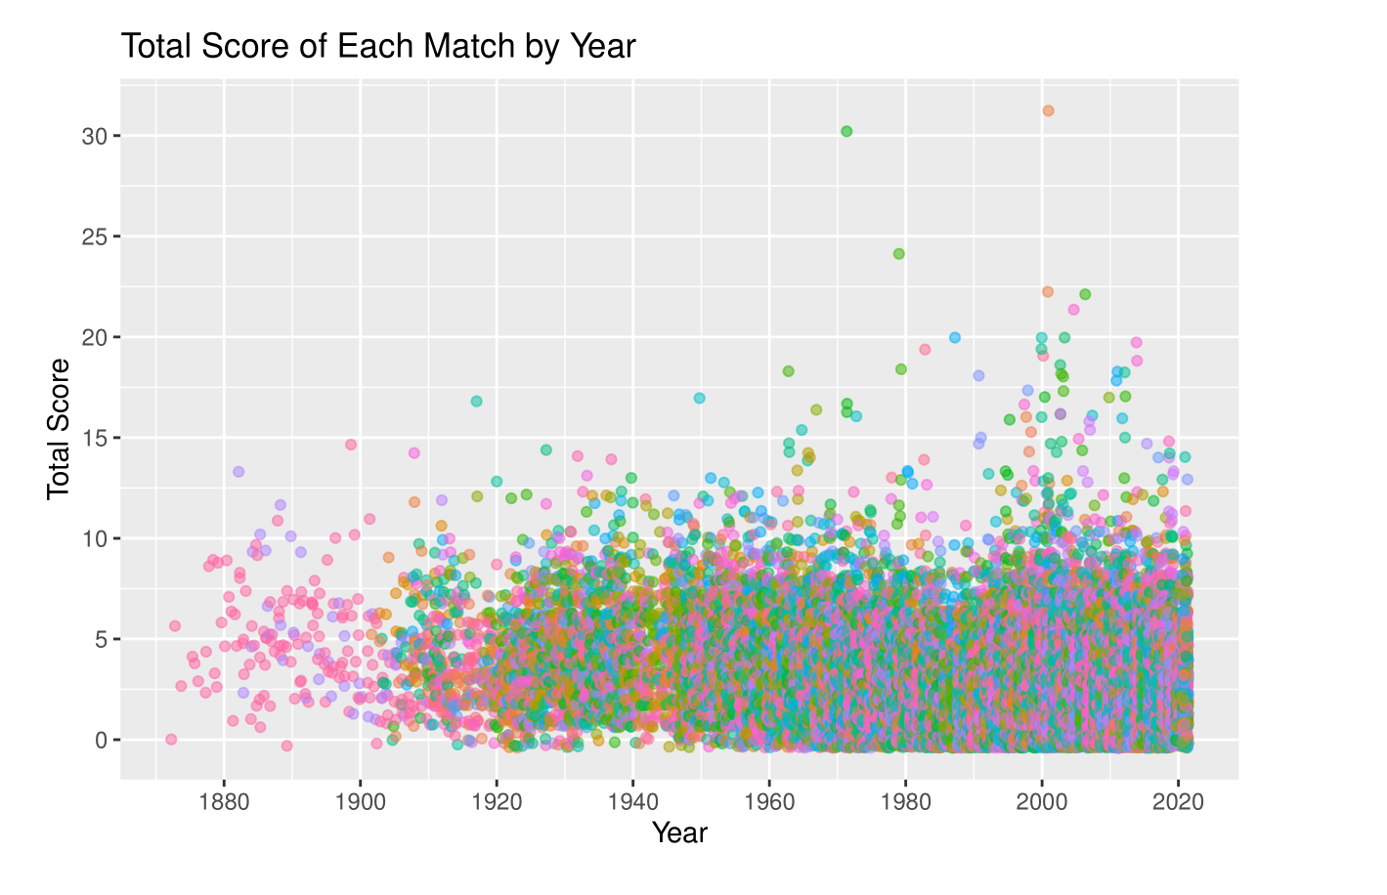
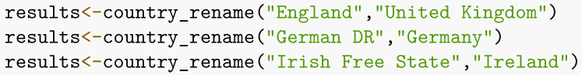
CHALLENGES
Problem: Way too many countries to be meaningful
Solution: Bin them down to continents
Problem: How the heck do I do that?
Solution: library(countrycode)
Problem: There are countries that don’t exist anymore
Solution: Create a function that can manually rename 1 country at a time

Slide 7
ANALYSIS

Slide 8
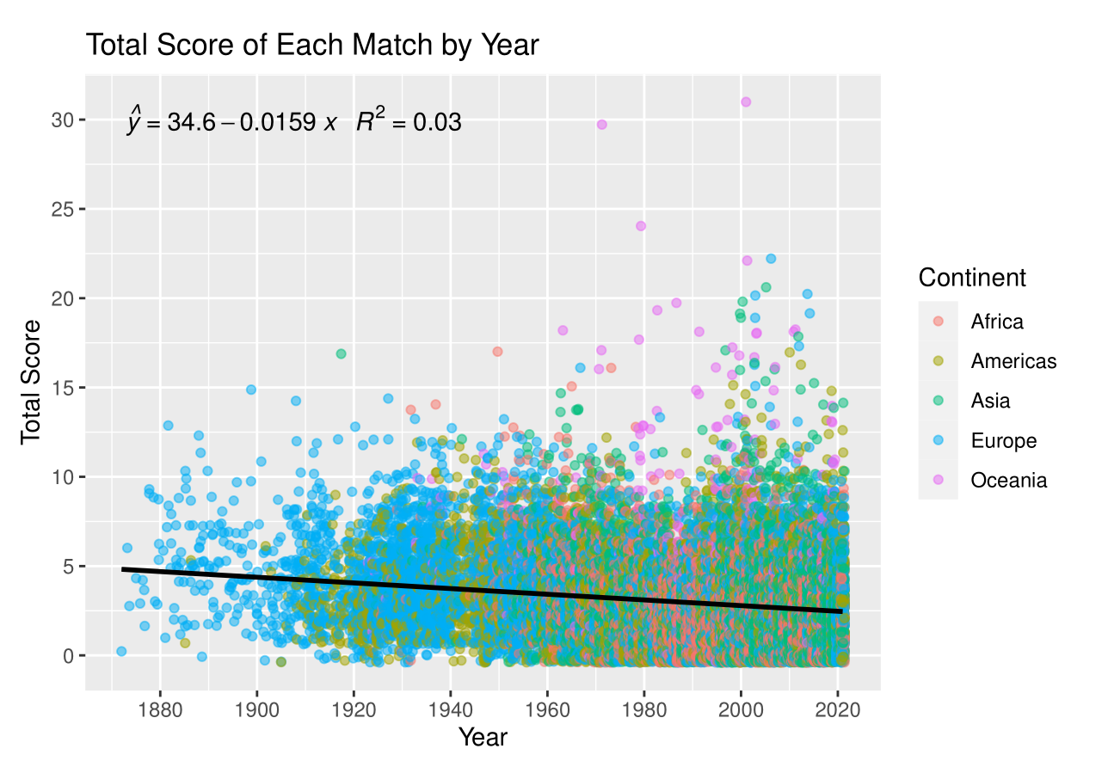
ANALYSIS 01
First real graph
Looking for patterns
Interesting LSRL but R² is poor

Slide 9
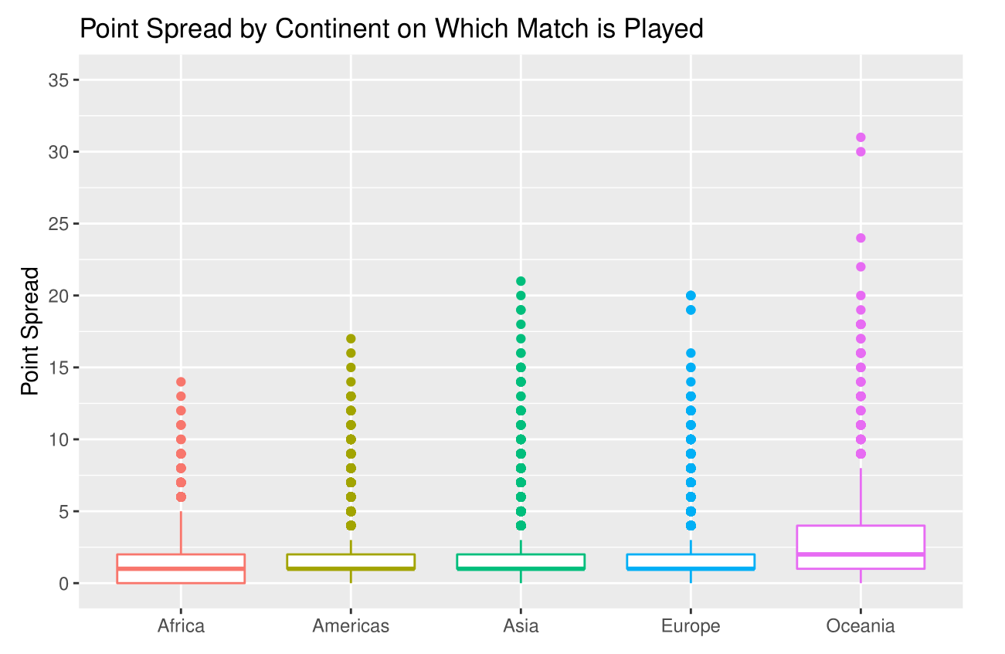
ANALYSIS 02
Oceania has much larger SD than other continents
Otherwise regular between continents
Point Spread = |Home Score-Away Score|

Slide 10
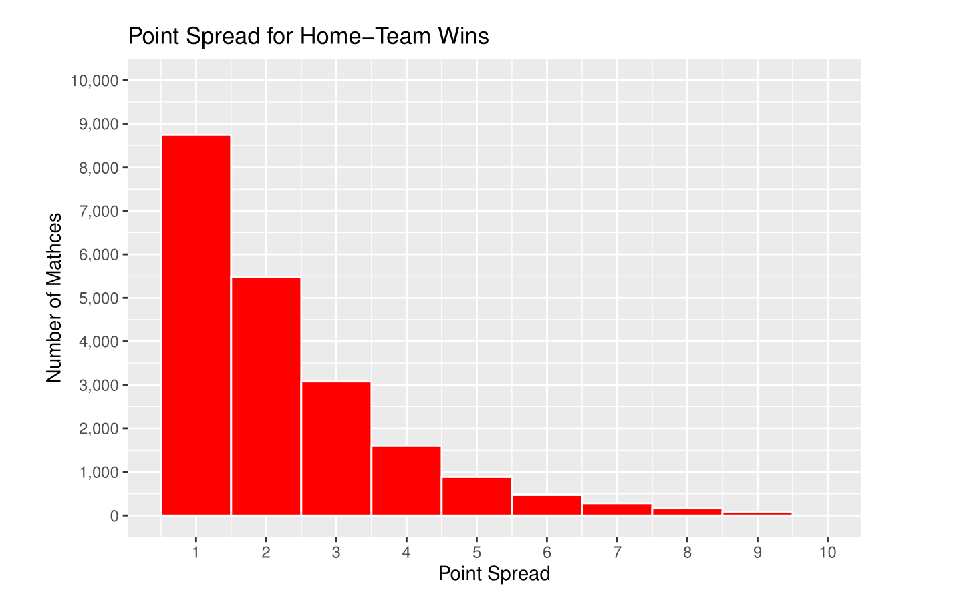
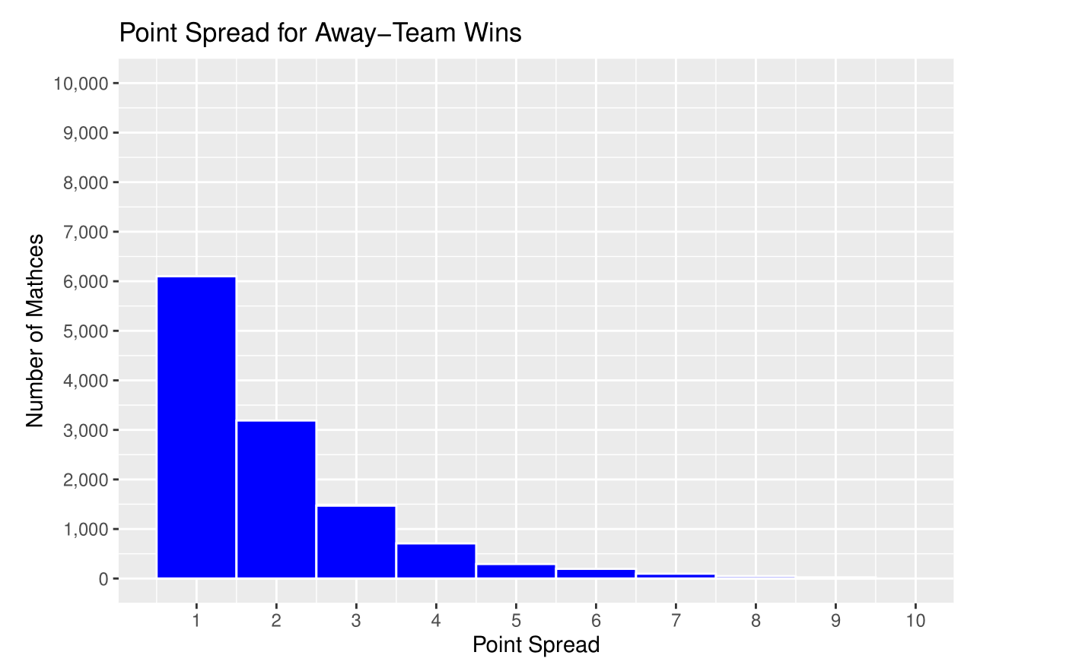
ANALYSIS 03
Home team has an advantage
This is because Away/Home is determined by which team is better

Slide 11
ANALYSIS 04
Neutral Field means game is played on the field of a third country
Home team has a big advantage on home fields: almost 2 to 1
Home team also has an advantage on neutral fields: 1.25 to 1
All
Matches
Neutral Field
Home
Field
Home Wins
48.6%
43.0%
50.5%
Away Wins
28.3%
34.2%
26.4%
Tie
23.0%
22.8%
23.1%

Slide 12
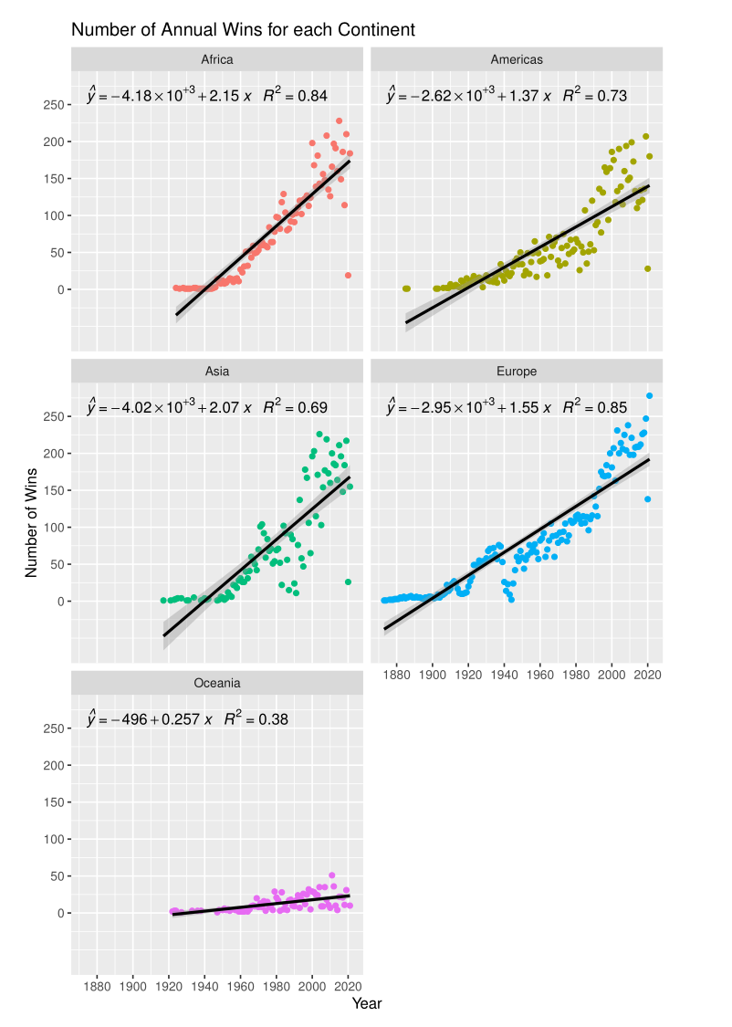
ANALYSIS 05
This graph shows each continent’s growth in annual wins each year
Africa has grown the most with a M of 2.15
Oceania has grown the least with a M of 0.26

Slide 13
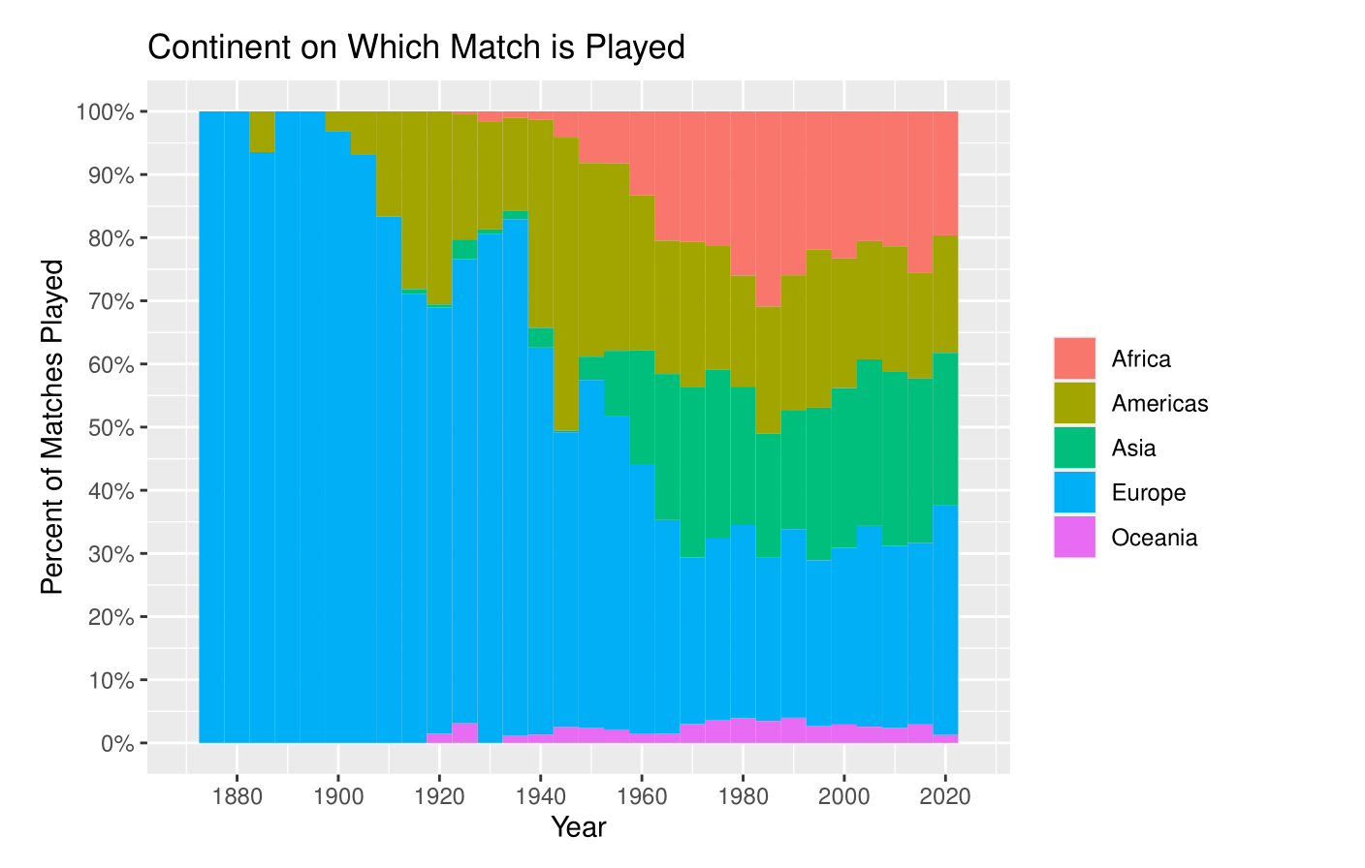
ANALYSIS 06
Shows change in where soccer is played
Started in Europe and is now fairly distributed

Slide 14
CONCLUSIONS

Slide 15

CONCLUSIONS
Oceania has much larger SD than other continents
Home team has an advantage, on both neutral and non-neutral fields
Home team has a BIG advantage on non-neutral fields
Africa has the largest win’s growth rate
Oceania is growing the slowest
Soccer started in Europe and is now fairly distributed across all continents

Slide 16
FUTURE WORK
Look more closely at outliers
Look more closely at home team advantage on neutral fields
Look more closely at the nonlinear annual growth
Separate home team advantage for neutral and home fields

Slide 17
THANK YOU

